Slide 1
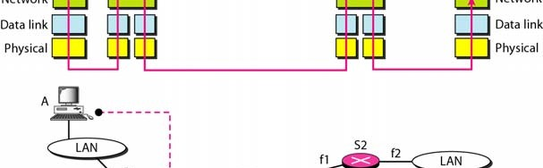
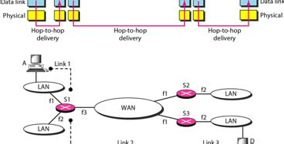
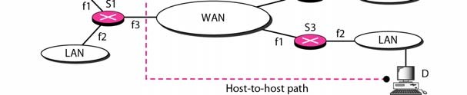
1/11/2010
Module IV Network Layer
IP and Address Mapping
Network layer in an internetwork
20.2
Based on
th
Data Communications and Networking, 4 Edition. by Behrouz A. Forouzan, McGraw-Hill Companies, Inc., 2007 Dr. Mznah Al-Rodhaan

Slide 2
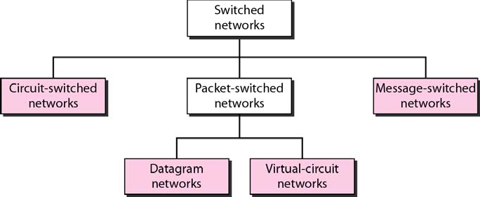
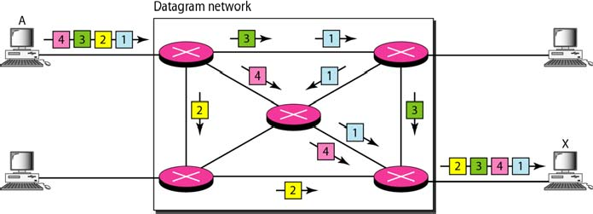
1/11/2010
Taxonomy of switched networks
Connectionless
Connection-oriented
Based on
Data Communications and Networking, 4th Edition. by Behrouz A. Forouzan, McGraw-Hill Companies, Inc., 2007 Dr. Mznah Al-Rodhaan
A datagram network with four switches (routers)
Based on
Data Communications and Networking, 4th Edition. by Behrouz A. Forouzan, McGraw-Hill Companies, Inc., 2007 Dr. Mznah Al-Rodhaan

Slide 3
1/11/2010
Switching in the Internet
Switching at the network layer in the Internet uses the datagram approach to packet switching.
Communication at the network layer in the Internet is connectionless.
Based on
Data Communications and Networking, 4th Edition. by Behrouz A. Forouzan, McGraw-Hill Companies, Inc., 2007 Dr. Mznah Al-Rodhaan
IPv4
The Internet Protocol version 4 (IPv4) is the delivery mechanism used by the TCP/IP protocols..
Topics discussed in this section:
Datagram Fragmentation Checksum Options
20.6
Based on
th
Data Communications and Networking, 4 Edition. by Behrouz A. Forouzan, McGraw-Hill Companies, Inc., 2007 Dr. Mznah Al-Rodhaan

Slide 4
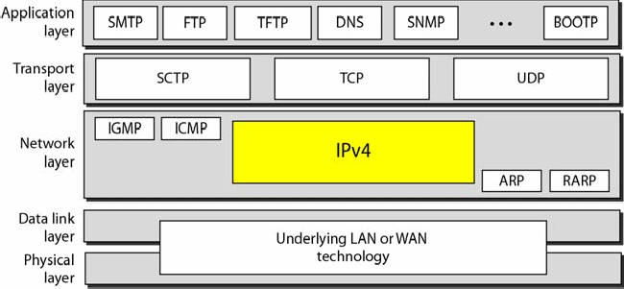
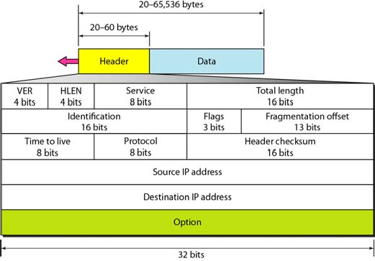
1/11/2010
Position of IPv4 in TCP/IP protocol suite
20.7
Based on
th
Data Communications and Networking, 4 Edition. by Behrouz A. Forouzan, McGraw-Hill Companies, Inc., 2007 Dr. Mznah Al-Rodhaan
IPv4 datagram format
20.8
Based on
th
Data Communications and Networking, 4 Edition. by Behrouz A. Forouzan, McGraw-Hill Companies, Inc., 2007 Dr. Mznah Al-Rodhaan

Slide 5
1/11/2010
IP Packet Format
0
4 8
Version HLEN
Service
16
19
Length
31
Identification
Flags Fragment Offset
IP Header Checksum
TTL
Protocol
Source IP Address
Destination IP Address Options (variable)
Data
Pad (variable)
Based on
Data Communications and Networking, 4th Edition. by Behrouz A. Forouzan, McGraw-Hill Companies, Inc., 2007 Dr. Mznah Al-Rodhaan
Current IP Protocol Version is 4, called IPv4
0
4
8
16
19
31
Version | HLEN | Services | Length
Identification |  |  | Flags | Fragment Offset
TTL |  | Protocol | IP Header Checksum
Source IP Address
Destination IP Address
Options (variable)
Based on
Data Communications and Networking, 4th Edition. by Behrouz A. Forouzan, McGraw-Hill Companies, Inc., 2007 Dr. Mznah Al-Rodhaan

Slide 6
1/11/2010
Length of IP Header in number of 4 bytes words including options. Maximum header size is 60 bytes. Header length = HLEN*4
0
4
8
16
19
31
Version | HLEN | Services | Length
Identification |  |  | Flags | Fragment Offset
TTL |  | Protocol | IP Header Checksum
Source IP Address
Destination IP Address
Options (variable)
Based on
Data Communications and Networking, 4th Edition. by Behrouz A. Forouzan, McGraw-Hill Companies, Inc., 2007
Dr. Mznah Al-Rodhaan
The service field is composed of a 3-bit precedence field. (Which are largely ignored in current routers). 4 services bits and an unused bit that must be zero.
0
4
8
16
19
31
Version | HLEN | Services | Length
Identification |  |  | Flags | Fragment Offset
TTL |  | Protocol | IP Header Checksum
Source IP Address
Destination IP Address
Options (variable)
Based on
Data Communications and Networking, 4th Edition. by Behrouz A. Forouzan, McGraw-Hill Companies, Inc., 2007
Dr. Mznah Al-Rodhaan

Slide 7
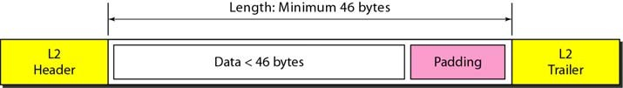
1/11/2010
Total length of IP datagram in bytes. It is a 16 bit field. Largest size of an IP datagram is 65635 bytes. Maximum header size is 60 bytes. Link layer MTU may restrict this size further.
0
4
8
16
19
31
Version | HLEN | Services | Length
Identification |  |  | Flags | Fragment Offset
TTL |  | Protocol | IP Header Checksum
Source IP Address
Destination IP Address
Options (variable)
Based on
Data Communications and Networking, 4th Edition. by Behrouz A. Forouzan, McGraw-Hill Companies, Inc., 2007 Dr. Mznah Al-Rodhaan
Identification field uniquely identifies each datagram sent by a host. It is normally incremented by one each time a host sends a datagram. Very useful for fragmentation and reassembly.
0
4
8
16
19
31
Version | HLen | Services | Length
Identification |  |  | Flags | Fragment Offset
TTL |  | Protocol | IP Header Checksum
Source IP Address
Destination IP Address
Options (variable)
Based on
Data Communications and Networking, 4th Edition. by Behrouz A. Forouzan, McGraw-Hill Companies, Inc., 2007 Dr. Mznah Al-Rodhaan

Slide 8

1/11/2010
flags field also used for fragmentation and reassembly.
0
4
8
16
19
31
Version | HLen | Services | Length
Identification |  |  | Flags | Fragment Offset
TTL |  | Protocol | IP Header Checksum
Source IP Address
Destination IP Address
Options (variable)
Based on
Data Communications and Networking, 4th Edition. by Behrouz A. Forouzan, McGraw-Hill Companies, Inc., 2007 Dr. Mznah Al-Rodhaan
Fragmentation offset used for fragmentation and reassembly. It shows the position of this fragment with respect to the whole datagram.
0
4
8
16
19
31
Version | HLen | Services | Length
Identification |  |  | Flags | Fragment Offset
TTL |  | Protocol | IP Header Checksum
Source IP Address
Destination IP Address
Options (variable)
Based on
Data Communications and Networking, 4th Edition. by Behrouz A. Forouzan, McGraw-Hill Companies, Inc., 2007 Dr. Mznah Al-Rodhaan

Slide 9
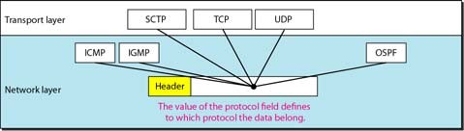
1/11/2010
Time-to-live (TTL ) field sets an upper limit on how man routers a datagram can go through. Every router decrements TTL by 1 before sending it forward. If TTL reaches 0 the datagram is dropped and an ICMP message is sent to the host application.
0
4
Version HLen
8
Services
16
19
Length
31
Identification
Flags Fragment Offset
TTL
Protocol IP Header Checksum
Source IP Address Destination IP Address
Options (variable)
Based on
Data Communications and Networking, 4th Edition. by Behrouz A. Forouzan, McGraw-Hill Companies, Inc., 2007 Dr. Mznah Al-Rodhaan
Identifies the protocol that sent the datagram. The protocol (today) can be ICMP, IGMP, TCP, UDP
0
4 8 16 19 31
Version HLen Services Length
Identification Flags Fragment Offset
TTL
Protocol IP Header Checksum
Source IP Address Destination IP Address
Options (variable)
Based on
Data Communications and Networking, 4th Edition. by Behrouz A. Forouzan, McGraw-Hill Companies, Inc., 2007 Dr. Mznah Al-Rodhaan

Slide 10
1/11/2010
The header checksum is calculated over the IP header only. TCP, UDP etc protect their own data and header by a checksum.
0
4
Version HLEN
8
Services
16
19
Length
31
Identification
Flags Fragment Offset
TTL
Protocol IP Header Checksum
Source IP Address Destination IP Address
Options (variable)
Based on
Data Communications and Networking, 4th Edition. by Behrouz A. Forouzan, McGraw-Hill Companies, Inc., 2007 Dr. Mznah Al-Rodhaan
Example 20.1
An IPv4 packet has arrived with the first 8 bits as shown: 01000010
The receiver discards the packet Why?
Solution
(0100) show the version✓.
The next 4 bits (0010) show header length (2 × 4 = 8bytes). The minimum number of bytes in the header must be 20.
The packet has been corrupted in transmission.
Based on
Data Communications and Networking, 4th Edition. by Behrouz A. Forouzan, McGraw-Hill Companies, Inc., 2007 Dr. Mznah Al-Rodhaan

Slide 11
1/11/2010
Example 20.2
In an IPv4 packet, the value of HLEN is 1000 in binary. How many bytes of options are being carried by this packet?
Solution
The HLEN value is 8, which means the total number of bytes in the header is 8 × 4, or 32 bytes. The first 20 bytes are the base header, the next 12 bytes are the options.
Based on
Data Communications and Networking, 4th Edition. by Behrouz A. Forouzan, McGraw-Hill Companies, Inc., 2007 Dr. Mznah Al-Rodhaan
Example 20.3
In an IPv4 packet, the value of HLEN is 5, and the value of the total length field is 0x0028. How many bytes of data are being carried by this packet?
Solution
The HLEN value is 5, which means the total number of bytes in the header is 5 × 4, or 20 bytes (no options). The total length is 40 bytes, which means the packet is carrying 20 bytes of data (40 − 20).
20.22
Based on
th
Data Communications and Networking, 4 Edition. by Behrouz A. Forouzan, McGraw-Hill Companies, Inc., 2007 Dr. Mznah Al-Rodhaan

Slide 12

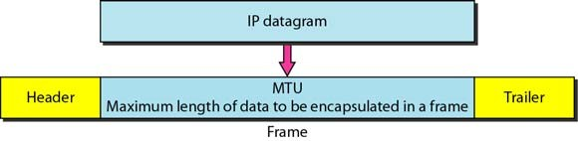
1/11/2010
Example 20.4
An IPv4 packet has arrived with the first few hexadecimal digits as shown.
0x45000028000100000102 . . .
How many hops can this packet travel before being dropped? The data belong to what upper-layer protocol?
Solution
To find the time-to-live field, we skip 8 bytes. The time-to- live field is the ninth byte, which is 01. This means the packet can travel only one hop. The protocol field is the next byte (02).
20.23
Based on
th
Data Communications and Networking, 4 Edition. by Behrouz A. Forouzan, McGraw-Hill Companies, Inc., 2007 Dr. Mznah Al-Rodhaan
Fragmentation
Maximum transfer unit (MTU)
20.24
Based on
th
Data Communications and Networking, 4 Edition. by Behrouz A. Forouzan, McGraw-Hill Companies, Inc., 2007 Dr. Mznah Al-Rodhaan

Slide 13
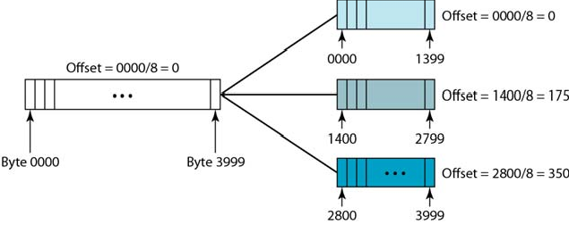
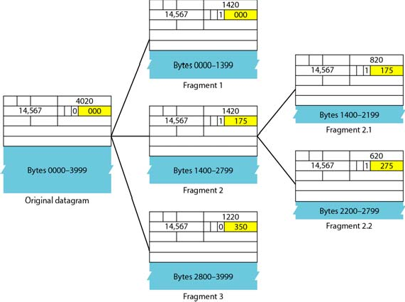
1/11/2010
Fragmentation example
20.25
Based on
th
Data Communications and Networking, 4 Edition. by Behrouz A. Forouzan, McGraw-Hill Companies, Inc., 2007 Dr. Mznah Al-Rodhaan
Detailed fragmentation example
20.26
Based on
th
Data Communications and Networking, 4 Edition. by Behrouz A. Forouzan, McGraw-Hill Companies, Inc., 2007 Dr. Mznah Al-Rodhaan

Slide 14
1/11/2010
Reading from the text book
Chapter 20 from 4th edition (section 20.1 until the end of page 594 except service Type and differentiated services )
Based on
Data Communications and Networking, 4th Edition. by Behrouz A. Forouzan, McGraw-Hill Companies, Inc., 2007 Dr. Mznah Al-Rodhaan
Chapter 21 Network Layer Address Mapping
Based on
Data Communications and Networking, 4th Edition. by Behrouz A. Forouzan, McGraw-Hill Companies, Inc., 2007 Dr. Mznah Al-Rodhaan

Slide 15
1/11/2010
20.29
Based on
th
Data Communications and Networking, 4 Edition. by Behrouz A. Forouzan, McGraw-Hill Companies, Inc., 2007 Dr. Mznah Al-Rodhaan
Address Mapping
The delivery of a packet to a host or a router requires two levels of addressing: logical and physical. We need to be able to map a logical address to its corresponding physical address and vice versa. This can be done by using either static or dynamic mapping.
Based on
Data Communications and Networking, 4th Edition. by Behrouz A. Forouzan, McGraw-Hill Companies, Inc., 2007 Dr. Mznah Al-Rodhaan

Slide 16
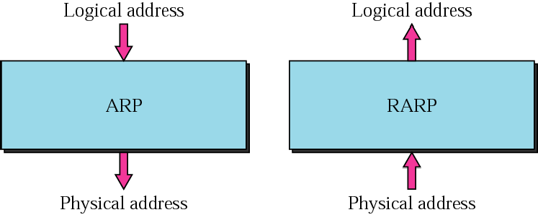
1/11/2010
ARP and RARP
Based on
Data Communications and Networking, 4th Edition. by Behrouz A. Forouzan, McGraw-Hill Companies, Inc., 2007 Dr. Mznah Al-Rodhaan
ARP - The Address Resolution Protocol
An IP datagram must be encapsulated in a frame to pass through the physical network. This requires the physical address of the receiver.
ARP associates an IP address with its physical address.
When the physical address of another host is required an ARP query packet is sent which includes
IP address of sender
IP address of the receiver
The intended recipient recognises its IP address and send back an ARP response which contains the physical address.
Based on
Data Communications and Networking, 4th Edition. by Behrouz A. Forouzan, McGraw-Hill Companies, Inc., 2007 Dr. Mznah Al-Rodhaan

Slide 17
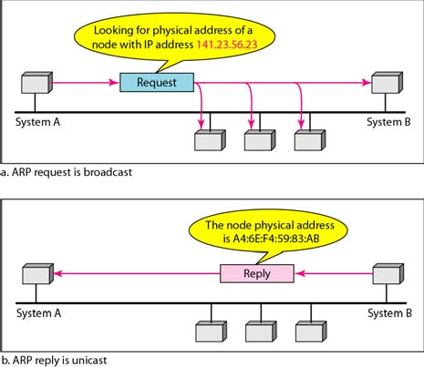
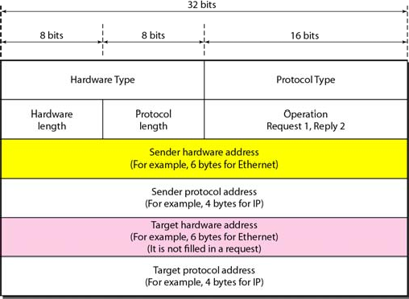
1/11/2010
ARP operation
Based on
Data Communications and Networking, 4th Edition. by Behrouz A. Forouzan, McGraw-Hill Companies, Inc., 2007 Dr. Mznah Al-Rodhaan
ARP packet
21.34
Based on
th
Data Communications and Networking, 4 Edition. by Behrouz A. Forouzan, McGraw-Hill Companies, Inc., 2007 Dr. Mznah Al-Rodhaan

Slide 18
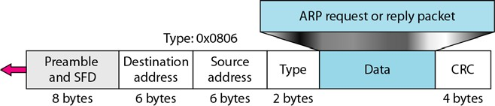
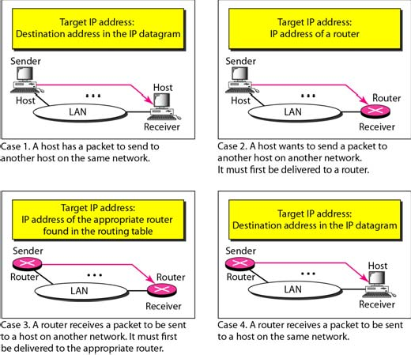
1/11/2010
Encapsulation of ARP packet
21.35
Based on
th
Data Communications and Networking, 4 Edition. by Behrouz A. Forouzan, McGraw-Hill Companies, Inc., 2007 Dr. Mznah Al-Rodhaan
Four cases using ARP
21.36
Based on
th
Data Communications and Networking, 4 Edition. by Behrouz A. Forouzan, McGraw-Hill Companies, Inc., 2007 Dr. Mznah Al-Rodhaan

Slide 19
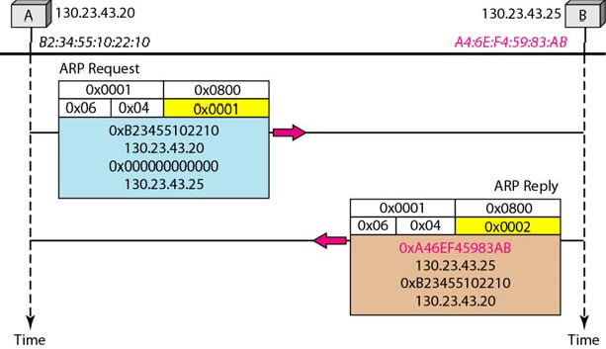
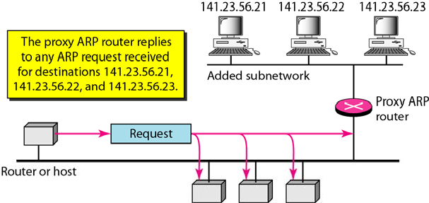
1/11/2010
ARP Request & Reply
Based on
Data Communications and Networking, 4th Edition. by Behrouz A. Forouzan, McGraw-Hill Companies, Inc., 2007 Dr. Mznah Al-Rodhaan
Proxy ARP
Based on
Data Communications and Networking, 4th Edition. by Behrouz A. Forouzan, McGraw-Hill Companies, Inc., 2007 Dr. Mznah Al-Rodhaan

Slide 20
1/11/2010
ARP functions
Sender knows IP address
IP asks ARP to create an ARP request message
sender physical address
sender IP address
target IP address
target physical address filled with 0's
Message passed to data link layer; destination address = broadcast address
All hosts receive frame; only target host accepts the packet
Target host replies (unicast) with an ARP reply message containing the physical address
Sender receives reply; it now knows the physical address of the target host
IP datagram's are now unicast to the destination host
Based on
Data Communications and Networking, 4th Edition. by Behrouz A. Forouzan, McGraw-Hill Companies, Inc., 2007 Dr. Mznah Al-Rodhaan
Cache Table
A sender usually has more than one IP datagram to send to the same destination
It is inefficient to use ARP for each datagram
A cache table is used
limited size
mappings retained only for a limited time
Based on
Data Communications and Networking, 4th Edition. by Behrouz A. Forouzan, McGraw-Hill Companies, Inc., 2007 Dr. Mznah Al-Rodhaan

Slide 21
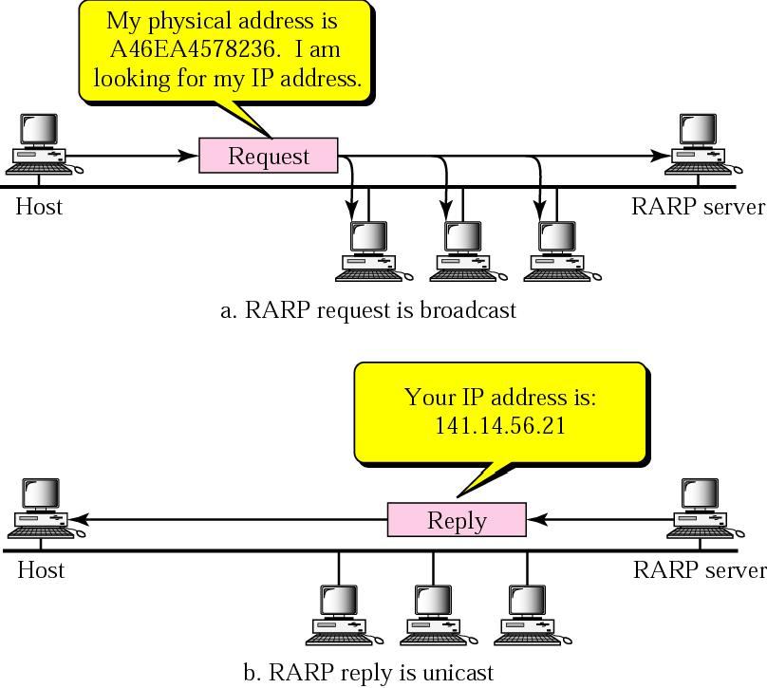
1/11/2010
RARP
Finds the logical address for a host that only knows its physical address
RARP request packets are broadcast; RARP reply packets are unicast
Used by diskless machines to obtain their IP addresses
DHCP is used now.
Based on
Data Communications and Networking, 4th Edition. by Behrouz A. Forouzan, McGraw-Hill Companies, Inc., 2007 Dr. Mznah Al-Rodhaan
Operation
Based on
Data Communications and Networking, 4th Edition. by Behrouz A. Forouzan, McGraw-Hill Companies, Inc., 2007 Dr. Mznah Al-Rodhaan

Slide 22
1/11/2010
DHCP provides static and dynamic address allocation that can be manual or automatic.
A request is broadcast; a reply is unicast.
Based on
Data Communications and Networking, 4th Edition. by Behrouz A. Forouzan, McGraw-Hill Companies, Inc., 2007 Dr. Mznah Al-Rodhaan
21-2 ICMP
The IP protocol has no error-reporting or error- correcting mechanism.. The IP protocol also lacks a mechanism for host and management queries. The Internet Control Message Protocol (ICMP) has been designed to compensate for the above two deficiencies. It is a companion to the IP protocol.
Topics discussed in this section:
Types of Messages Message Format Error Reporting
21.44
Based on
th
Data Communications and Networking, 4 Edition. by Behrouz A. Forouzan, McGraw-Hill Companies, Inc., 2007 Dr. Mznah Al-Rodhaan

Slide 23
1/11/2010
ICMP protocol
IP protocol is a best-effort delivery service, however it has two deficiencies
Lack of error control
Lack of assistance mechanisms
IP protocol has no error-reporting or error-correction mechanism
What happens when something goes wrong?
What happens if a router must discard a datagram because it cannot find a route to the final destination?
What if the time-to-live field has a zero value?
What if it has to discard all fragments because not all were received in a predetermined time limit?
IP protocol also lacks a mechanism for host and management queries.
ICMP was designed to compensate for these deficiencies.
Based on
Data Communications and Networking, 4th Edition. by Behrouz A. Forouzan, McGraw-Hill Companies, Inc., 2007 Dr. Mznah Al-Rodhaan
Internet Control Message Protocol (ICMP)
Encapsulated in IP packet
Handles error and control messages
If router cannot deliver or forward a packet, it sends an ICMP “host unreachable” message to the source
If router receives packet that should have been sent to another router, it sends an ICMP “redirect” message to the sender; Sender modifies its routing table
ICMP “router discovery” messages allow host to learn about routers in its network and to initialize and update its routing tables
Based on
Data Communications and Networking, 4th Edition. by Behrouz A. Forouzan, McGraw-Hill Companies, Inc., 2007 Dr. Mznah Al-Rodhaan

Slide 24
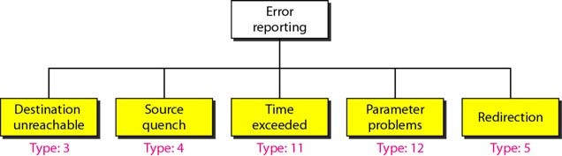
1/11/2010
ICMP always reports error messages to the original source.
Based on
Data Communications and Networking, 4th Edition. by Behrouz A. Forouzan, McGraw-Hill Companies, Inc., 2007 Dr. Mznah Al-Rodhaan
Error-reporting messages
21.48
Based on
th
Data Communications and Networking, 4 Edition. by Behrouz A. Forouzan, McGraw-Hill Companies, Inc., 2007 Dr. Mznah Al-Rodhaan

Slide 25
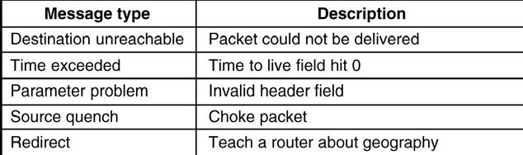
1/11/2010
Internet Control Message Protocol (ICMP)
ICMP is used by routers for exchanging error information and for testing. The principal ICMP message types are shown below.
Based on
Data Communications and Networking, 4th Edition. by Behrouz A. Forouzan, McGraw-Hill Companies, Inc., 2007 Dr. Mznah Al-Rodhaan
Important points about ICMP error messages:
No ICMP error message will be generated in response to a datagram carrying an ICMP error message.
No ICMP error message will be generated for a fragmented datagram that is not the first fragment.
No ICMP error message will be generated for a datagram having a multicast address.
No ICMP error message will be generated for a datagram having a special address such as
127.0.0.0 or 0.0.0.0.
21.50
Based on
th
Data Communications and Networking, 4 Edition. by Behrouz A. Forouzan, McGraw-Hill Companies, Inc., 2007 Dr. Mznah Al-Rodhaan

Slide 26
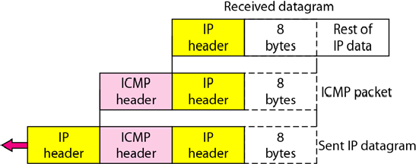
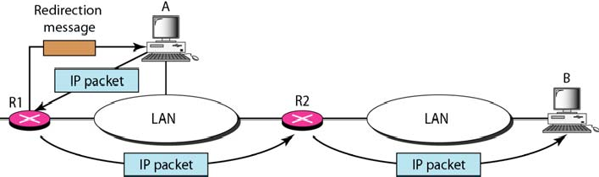
1/11/2010
Contents of data field for the error messages
21.51
Based on
th
Data Communications and Networking, 4 Edition. by Behrouz A. Forouzan, McGraw-Hill Companies, Inc., 2007 Dr. Mznah Al-Rodhaan
Redirection concept
21.52
Based on
th
Data Communications and Networking, 4 Edition. by Behrouz A. Forouzan, McGraw-Hill Companies, Inc., 2007 Dr. Mznah Al-Rodhaan

Slide 27
1/11/2010
Reading from the text book
Chapter 21 from 4th edition (section 21.1 until the first paragraph of page 625 except BOOTP page 619)
Based on
Data Communications and Networking, 4th Edition. by Behrouz A. Forouzan, McGraw-Hill Companies, Inc., 2007 Dr. Mznah Al-Rodhaan

